Slide 1
Exploration of Melbourne CBD pedestrian counts from 2009 to present
Yuqian Huang
28934172

Slide 2
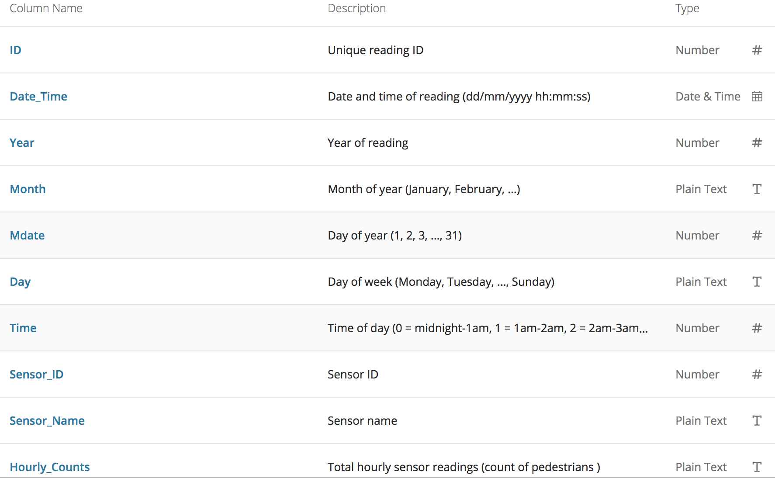
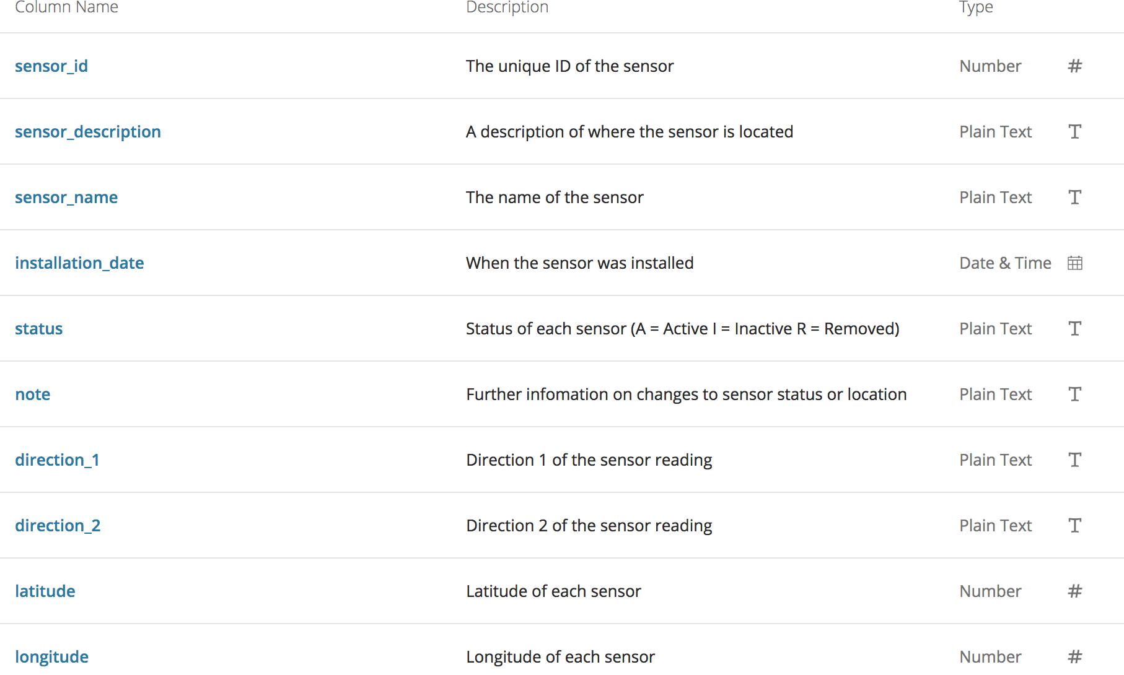
Dataset

Slide 3
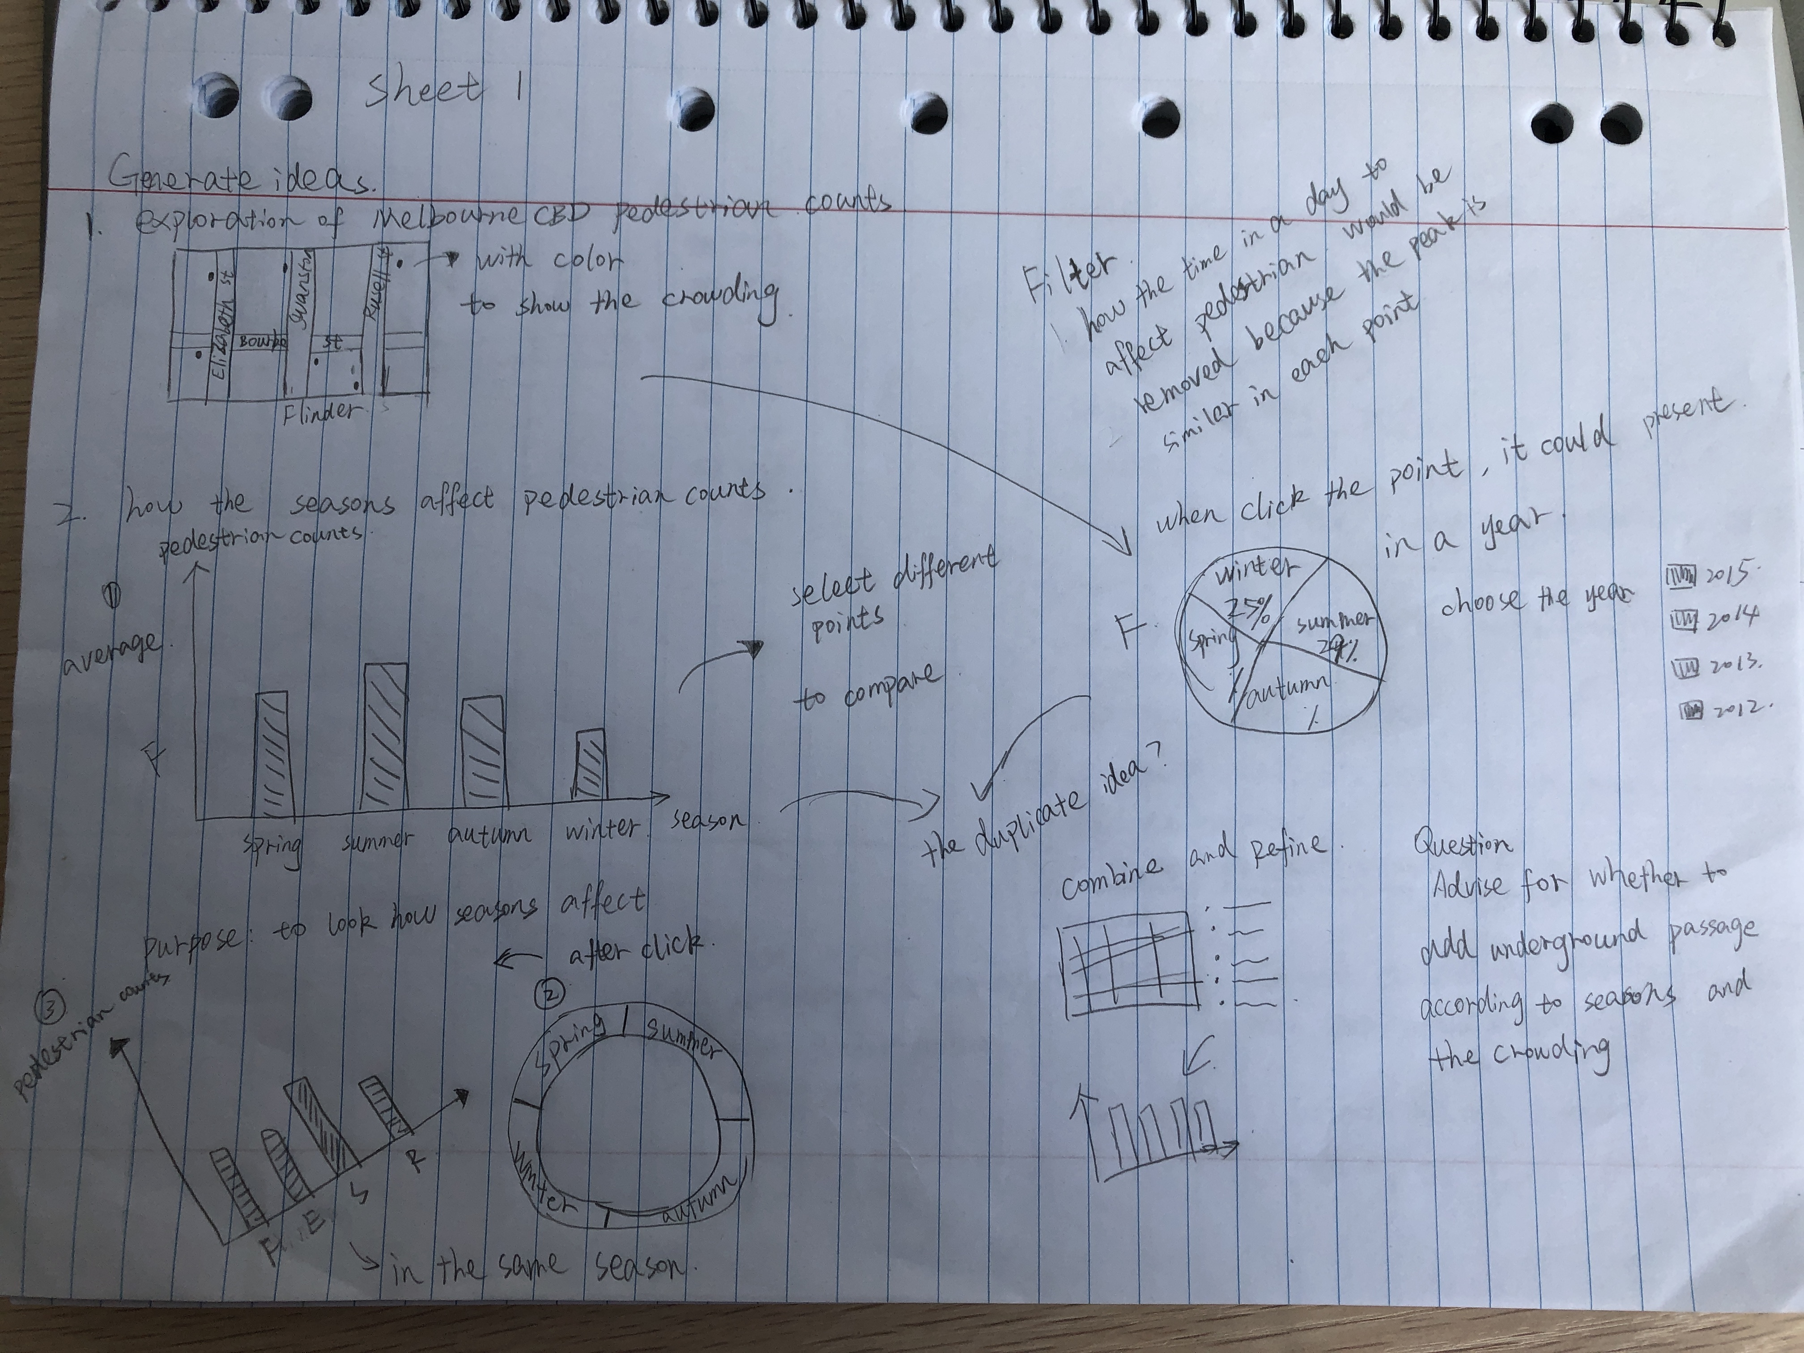
sheet 1

Slide 4
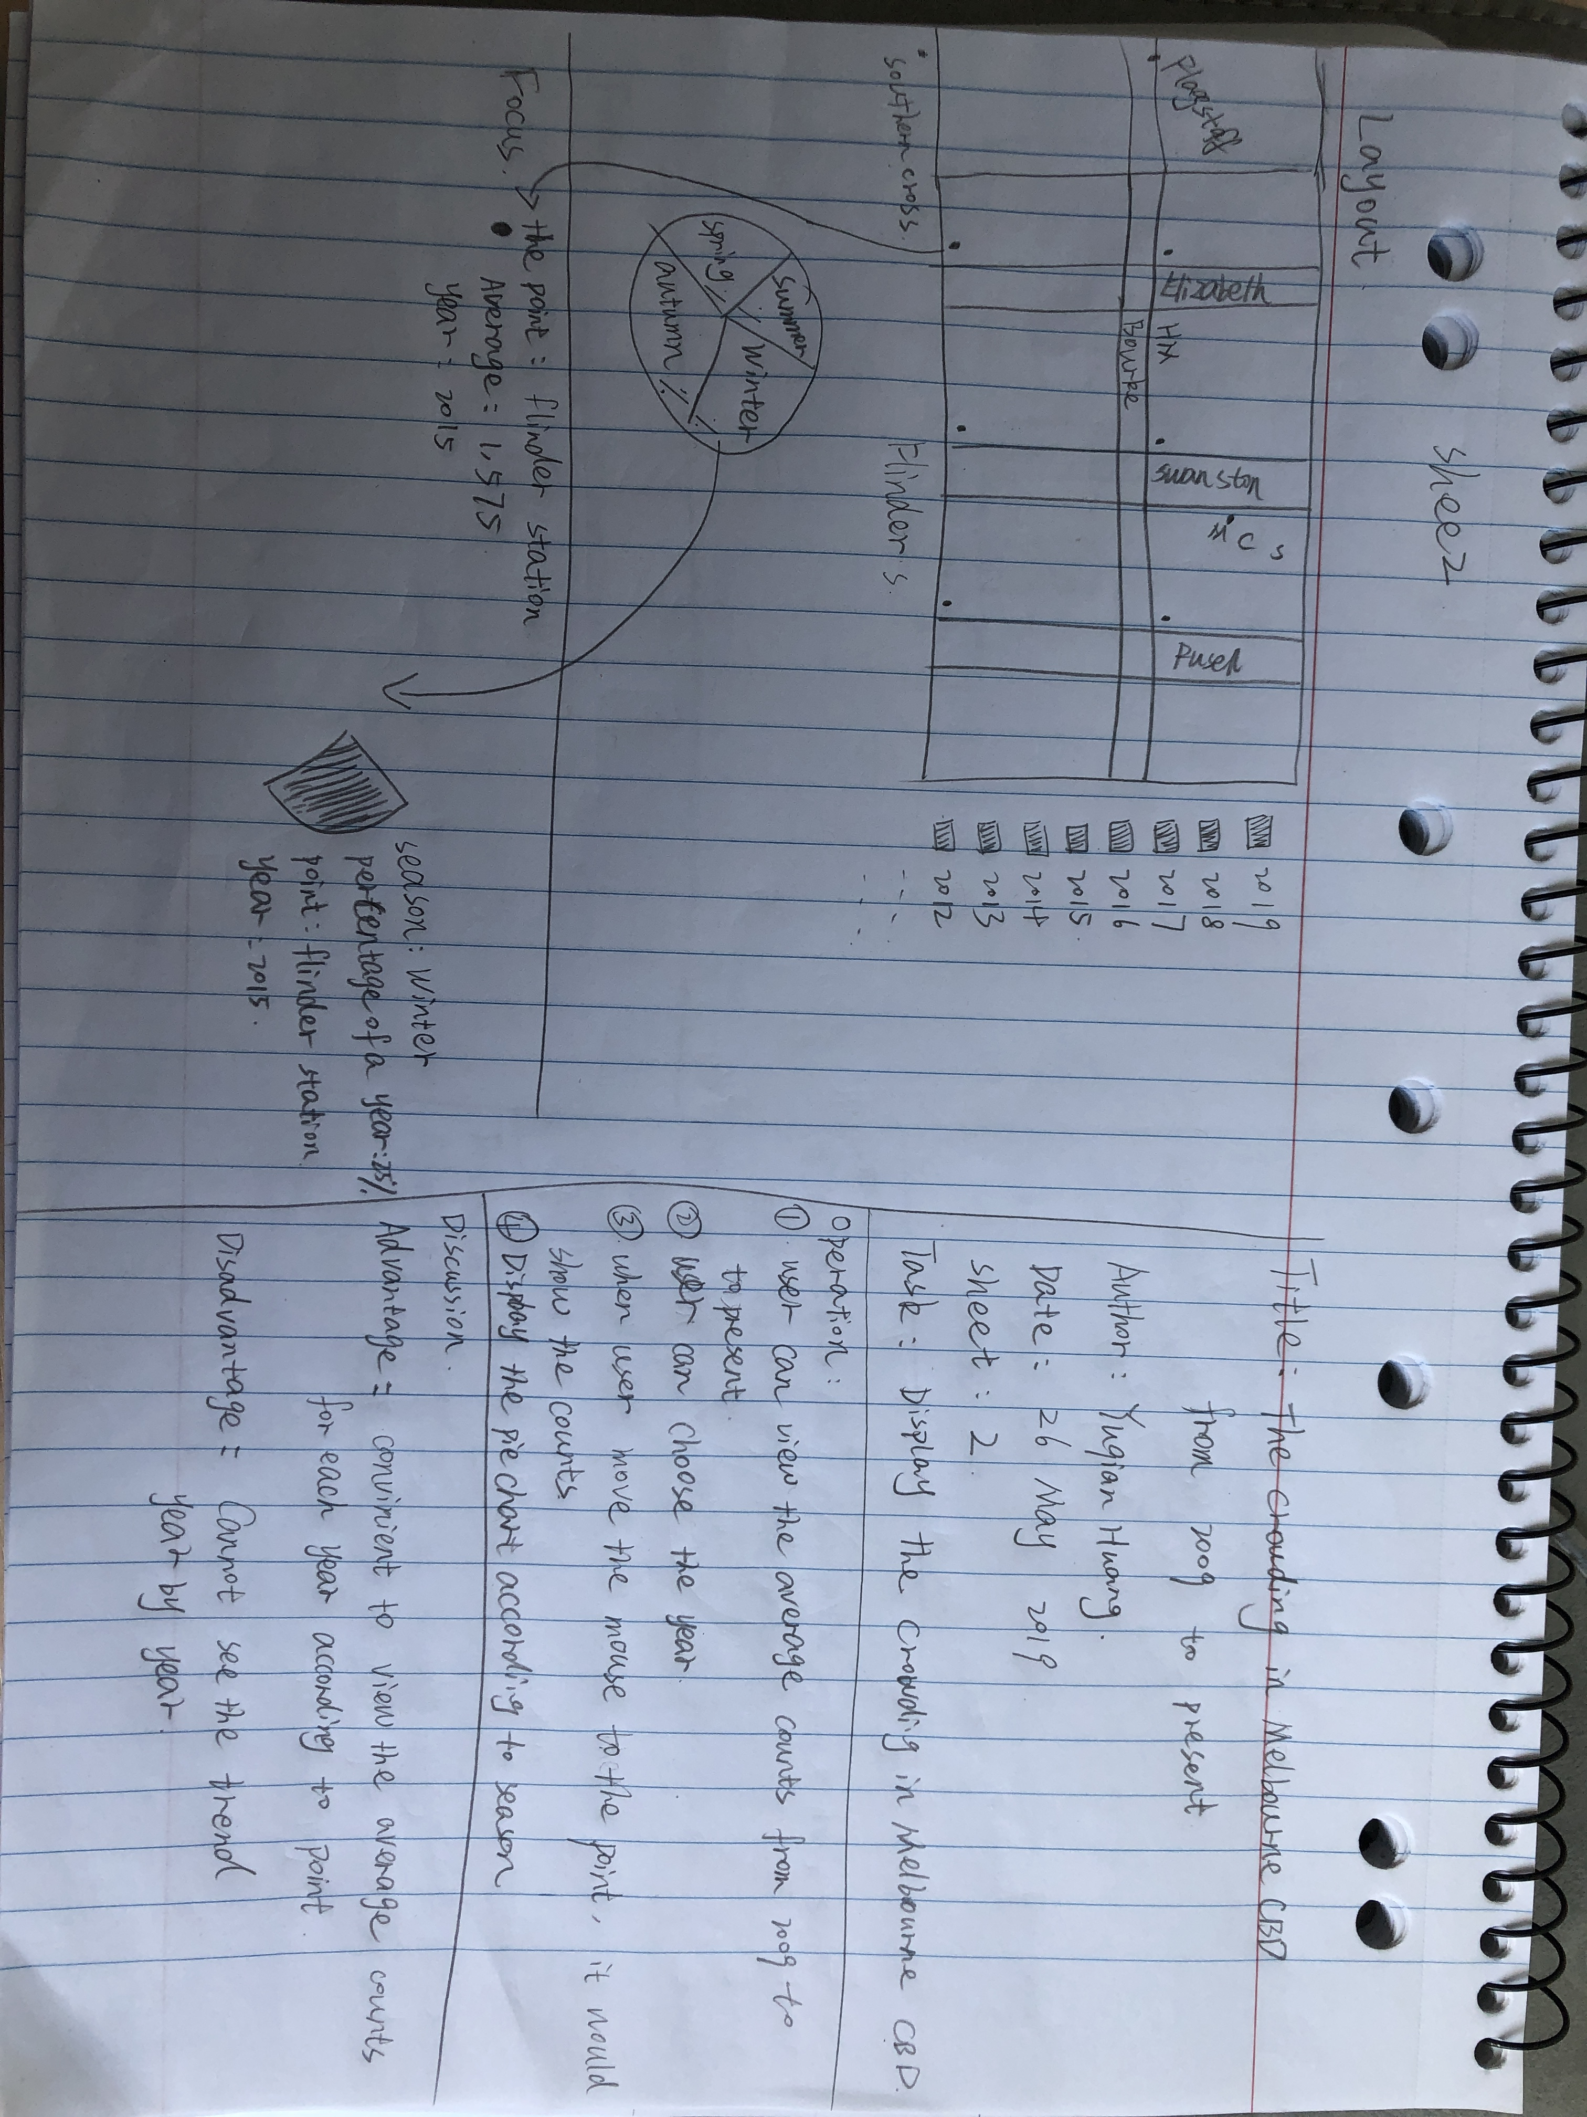
sheet 2

Slide 5
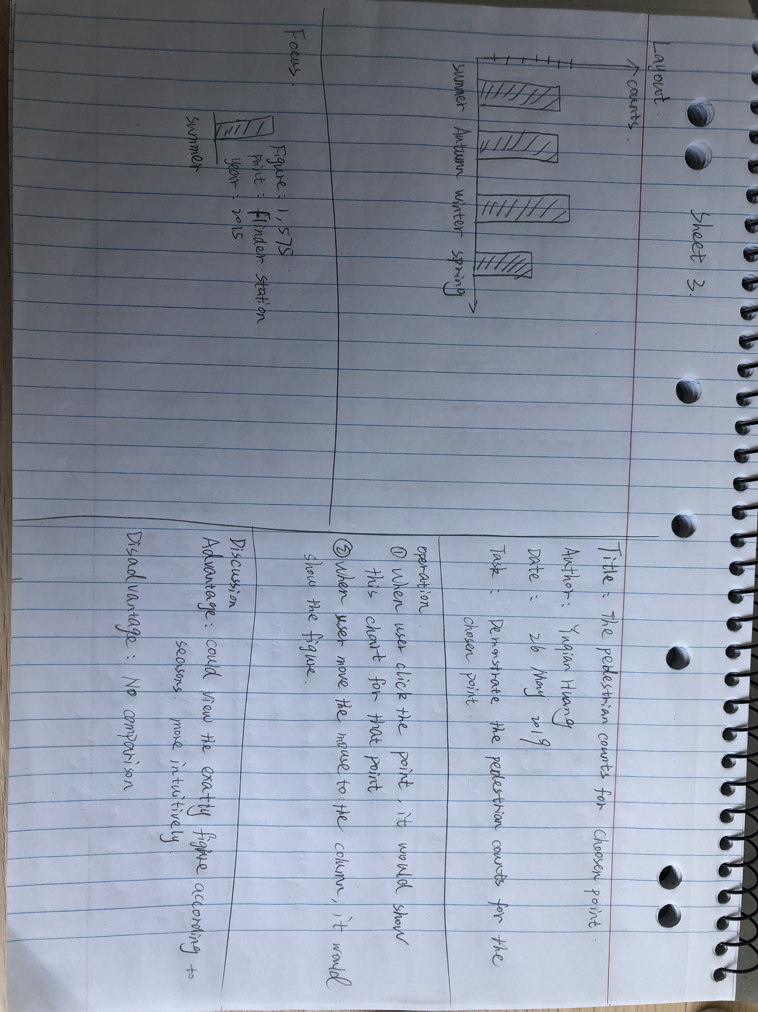
sheet 3

Slide 6
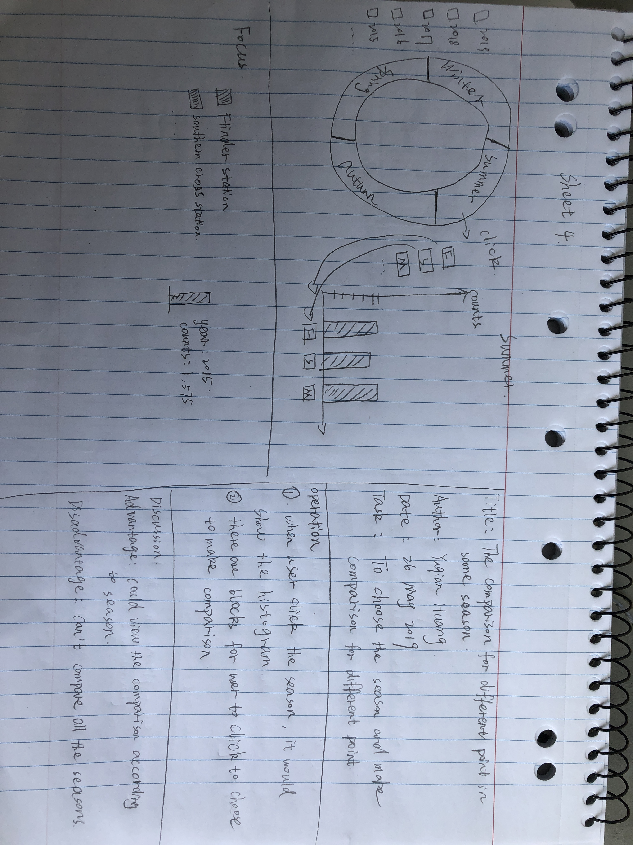
sheet 4

Slide 7
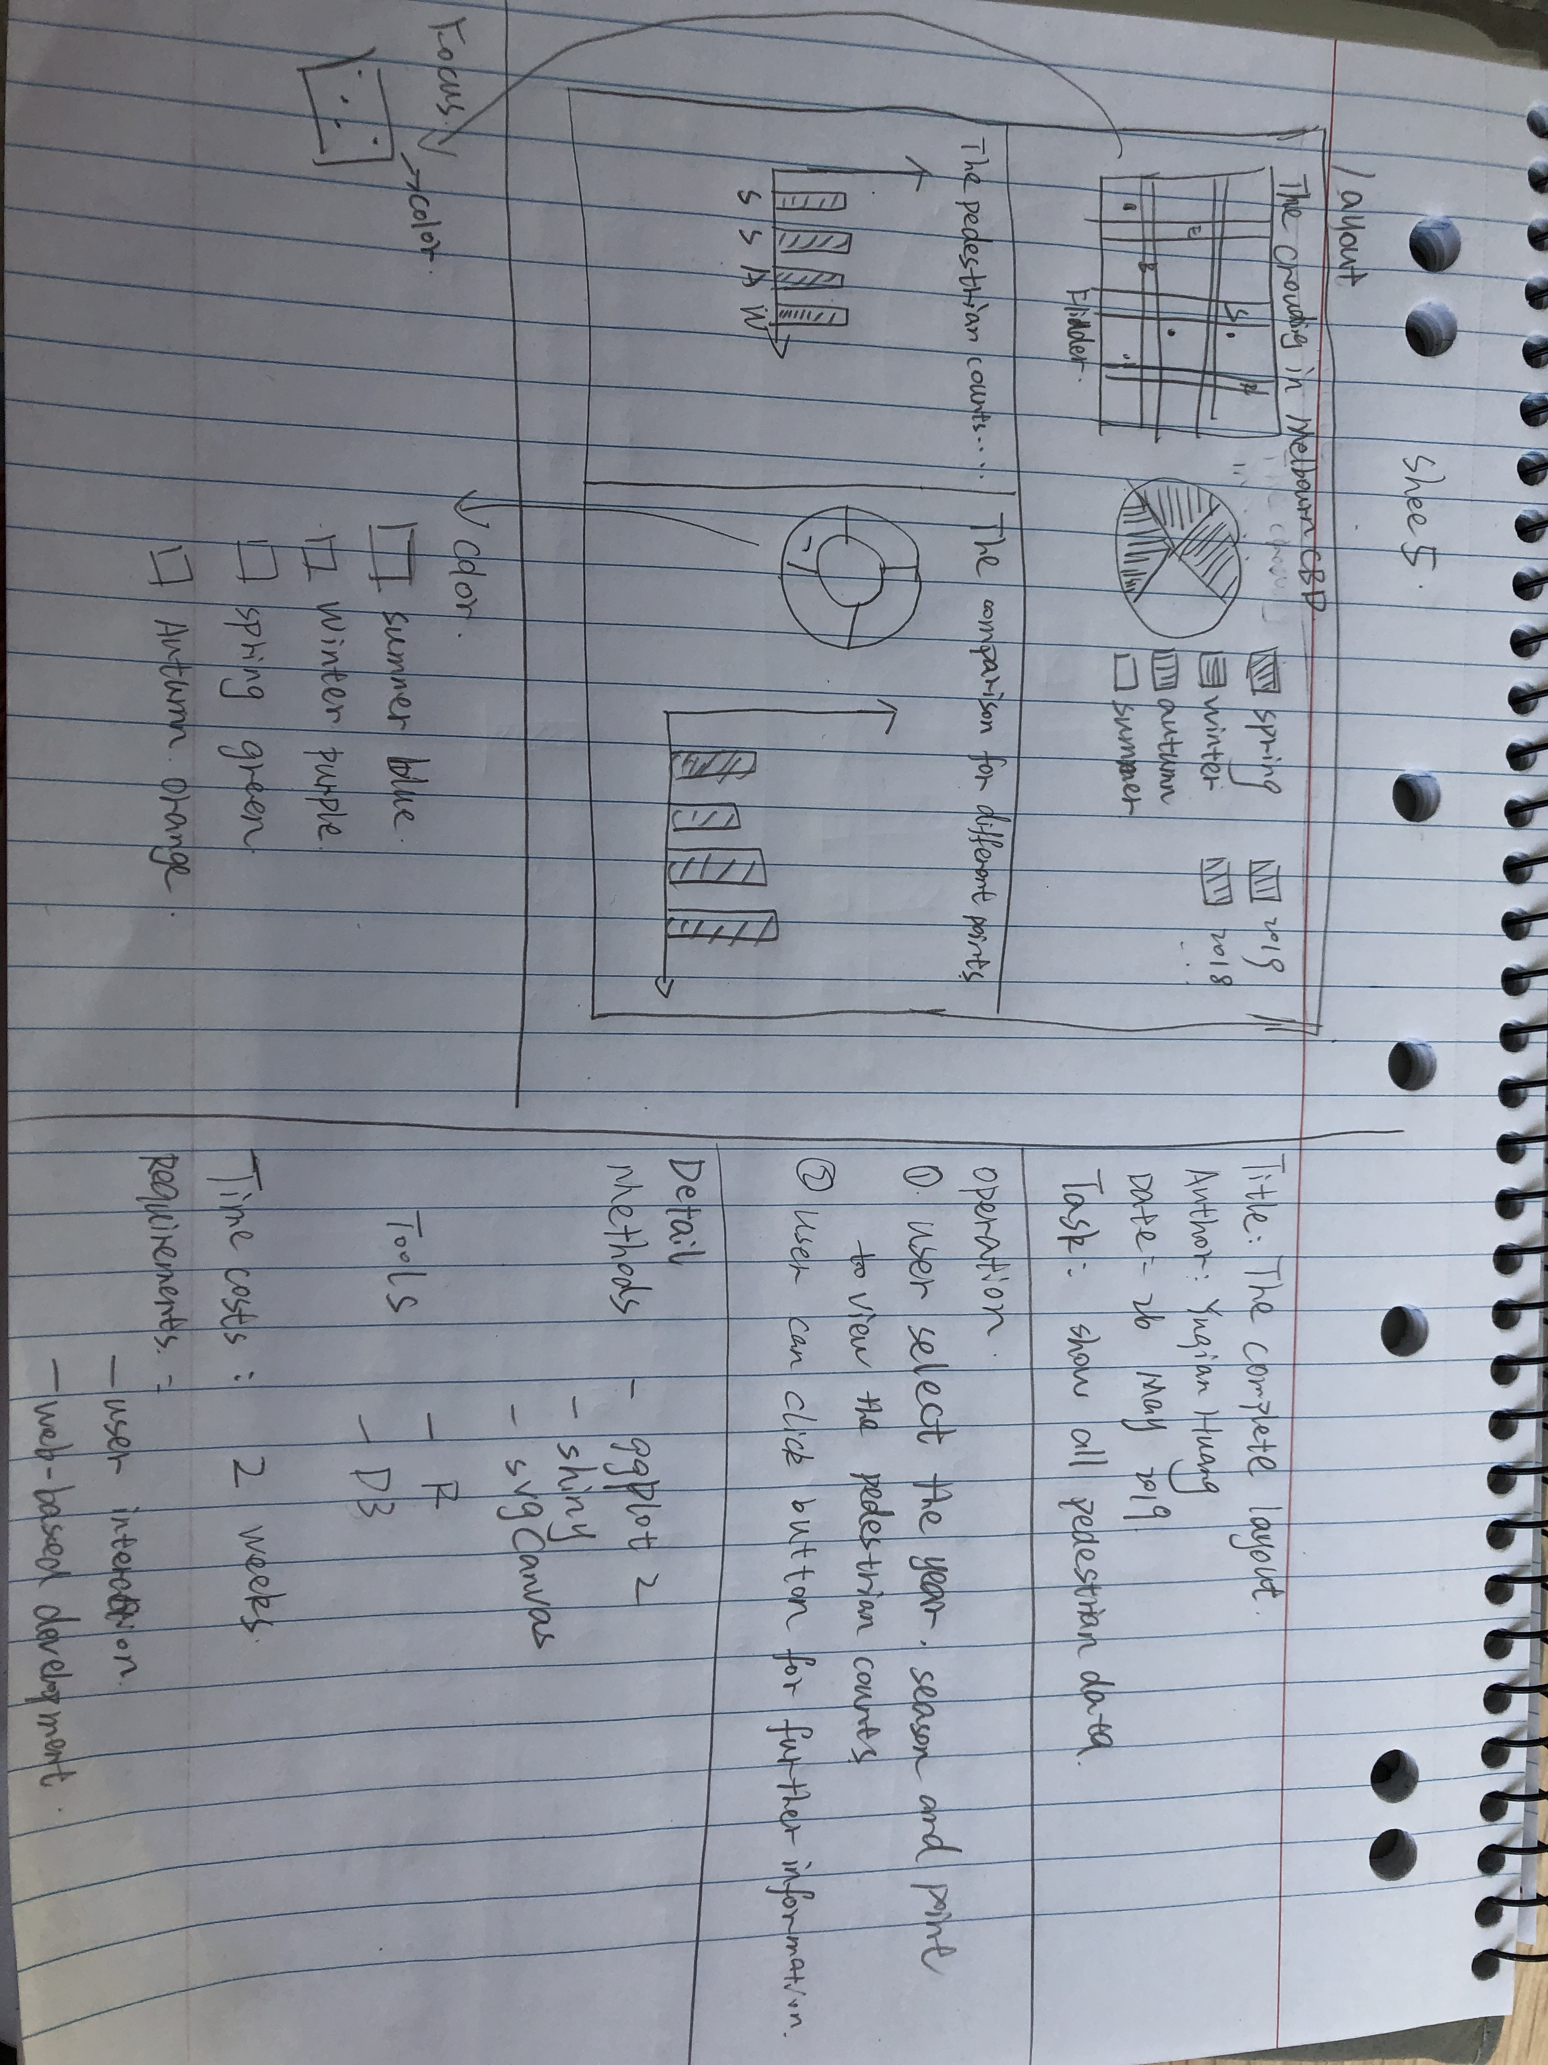
sheet 5

